Slide 1
Program Chat Sederhana
Muhammad Maksum (NIM. 362241009)
Salman Al Majali (NIM. 362241010)
Inov Whily (362489005)
Agung Wicaksono (362389010)

Slide 2
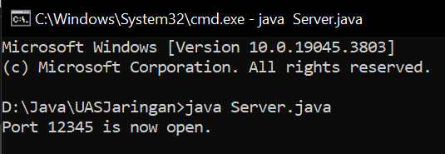
Process

Slide 3
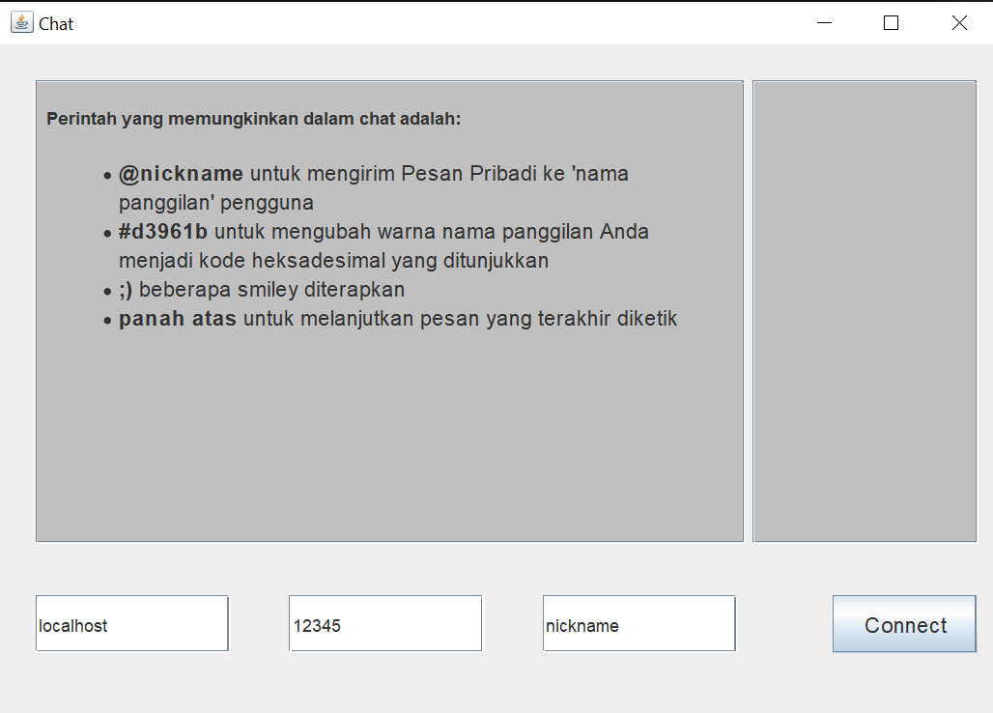
UI

Slide 4
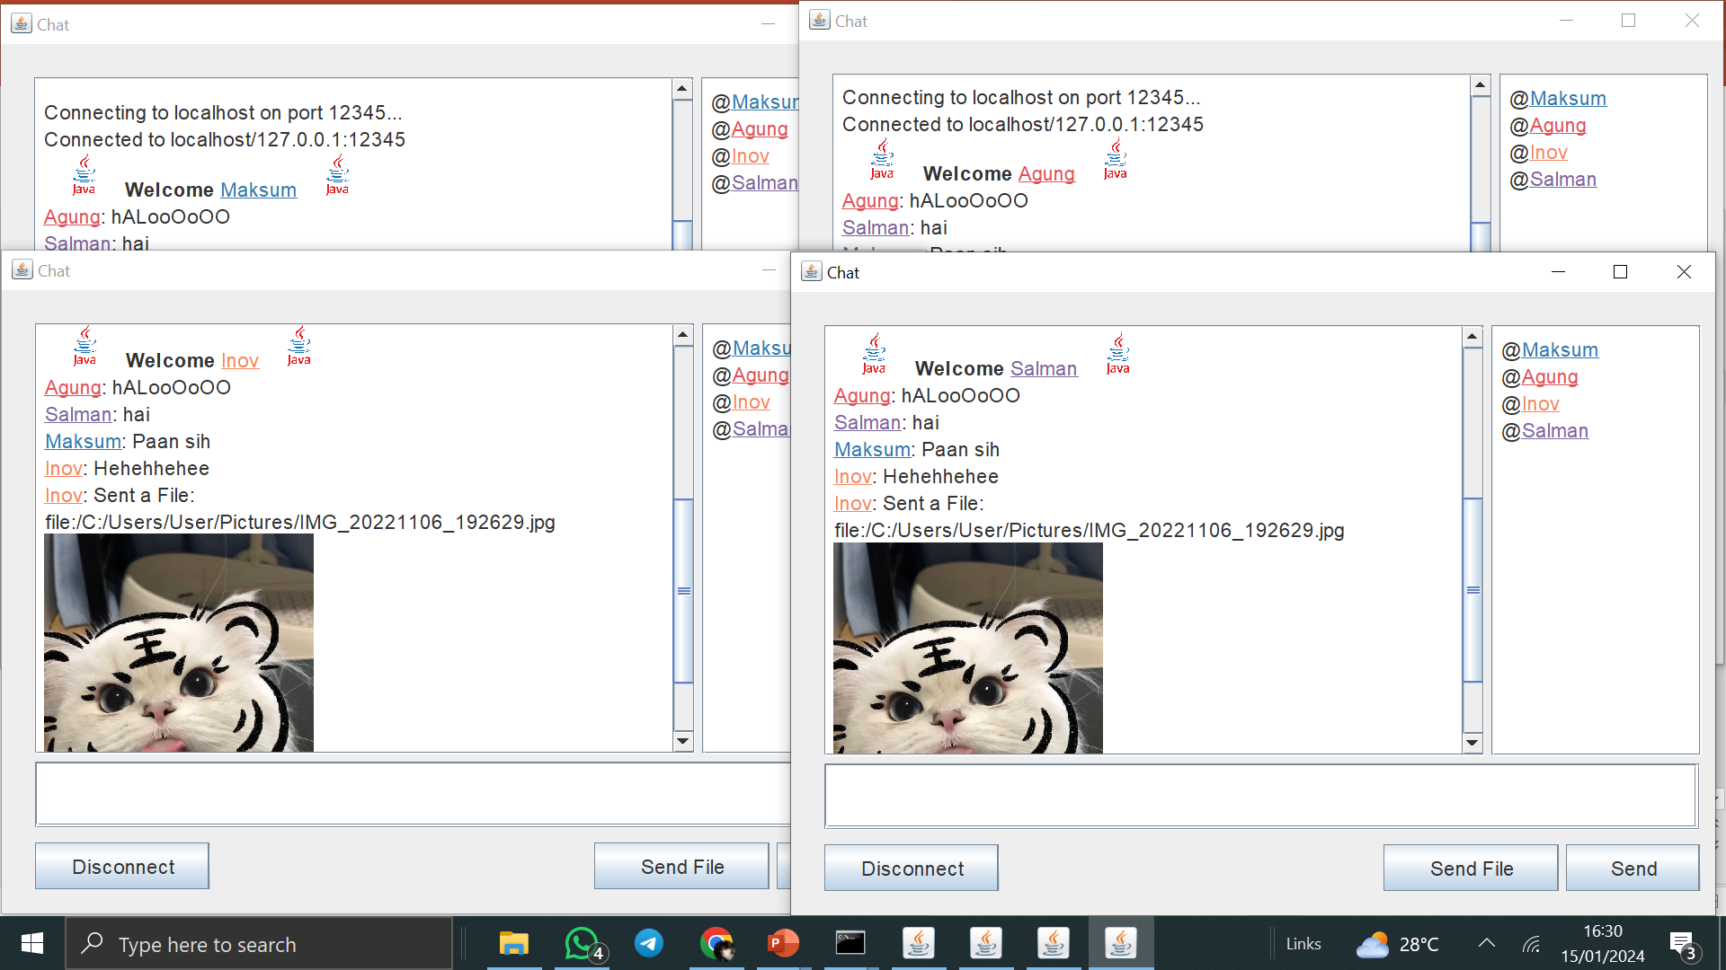
Implementation

Slide 5
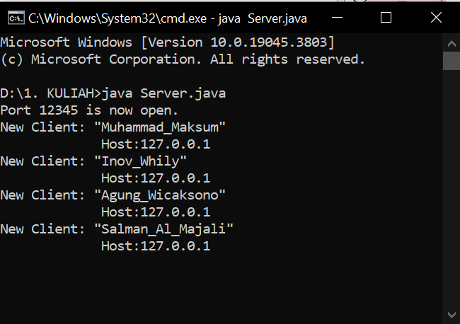

Slide 6
thank you
Kelompok X

